Slide 1
Optimise Aircraft fleet from 5 to 4 to meet SCiN demand by November, 2020
Wave ID
24164
Workstream
Opex
Current stage gate
L2
Initiative lead
Onyeka Ikechukwu
L4 date
November 2020
Location(s)
SCiN
L5 date
December 2020
Initiative sponsor
Victor Ojabo/Paul Van Den Hemel
Problem statement
Key stakeholders
Context: current demand for air transportation is met with 5 aircrafts broadly assigned to helibases (1x Warri, 2x PHC, 2x Lagos). Historic utilization of the aircraft flying capacity is trending at ~67%, consistent across helibases. Seat utilization is trending around 85%
Complications:
- Local supplier (Caverton Helicopters) profitability of which might be significantly impacted
Uncertainty of future demand outlook given COVID-19pand OPEC production cuts
GM/DMD; MD SNEPCo; PS Mgr
Asset Mgrs
GM Wells
GM C&P
SPDC FD/ SNEPCo FD
NAPIMS
Caverton Helicopters
Initiative description
Implementation plan: key actions required
Reduce aircraft fleet from 5 to 4 while meeting SCiN demand and not compromising on safety
Commercial:
Develop vendor engagement strategy (BATNA)
Engage the vendor to agree operating model with 4 aircrafts
Release the note to the vendor + 90 days notification period
Process:
“Demand on paper” exercise to identify required changes to demand management Incorporate changes to e2d LMS
Syndicate with key stakeholders
Operate based on revised process
Estimate impact
Risks:
Assumption: 4 aircrafts by November 1st, 2020
Savings: $348k/month saving on elimination of monthly aircraft rent element; total flying hours assumed to remain the same (redistributed between remaining 4 aircrafts resulting in higher capacity utilization)
Decreased service levels due to less spare capacity if demand surges (e.g., spike in the activities post-COVID, increased emergency response requirements, etc.)
Risk of vendor increasing rates for remaining services if they are unable to breakeven (mitigation: development of negotiation strategy as part of the implementation plan)

Slide 2
Simulated week
Analyses of historical data indicated potential opportunity to operate with 4 airframes with active demand management
2019-2020 total monthly helicopters demand
2019-2020 total monthly helicopters demand by helibase
Hours flown
Hours flown
PHC x2
Lagos x2
4 AC capacity (total)
5 AC capacity (total)
WARRI x1
200
40
2019 flight capacity¹ utilisation: 67%
2019 seat utilisation: 85%
20
Simulated week
150
0
Jan
Feb
Mar
Apr
May
Jun
Jul
Aug
Sep
Oct
Nov
Dec
Jan
Feb
Mar
Apr
COVID-19 crisis
PHC x2
100
80
60
40
50
20
0
Jan
Feb
Mar
Apr
May
Jun
Jul
Aug
Sep
Oct
Nov
Dec
Jan
Feb
Mar
Apr
0
Jan
Feb
Mar
Apr
May
Jun
Jul
Aug
Sep
Oct
Nov
Dec
Jan
Feb
Mar
Apr
LAGOS x2
80
On total fleet level, clear opportunity to operate with 4 airframes capacity
No individual base which would readily accommodate loss of an airframe – active demand management is required to maximize use of spare capacity (re-assigning the fleet based on pockets of demand vs dedication of aircrafts)
Simulation on average week to validate the opportnity
60
40
20
0
Jan
Feb
Mar
Apr
May
Jun
Jul
Aug
Sep
Oct
Nov
Dec
Jan
Feb
Mar
Apr
1 Capacity is based on 60% assumption of10.5 hrs a day 6 days a week

Slide 3
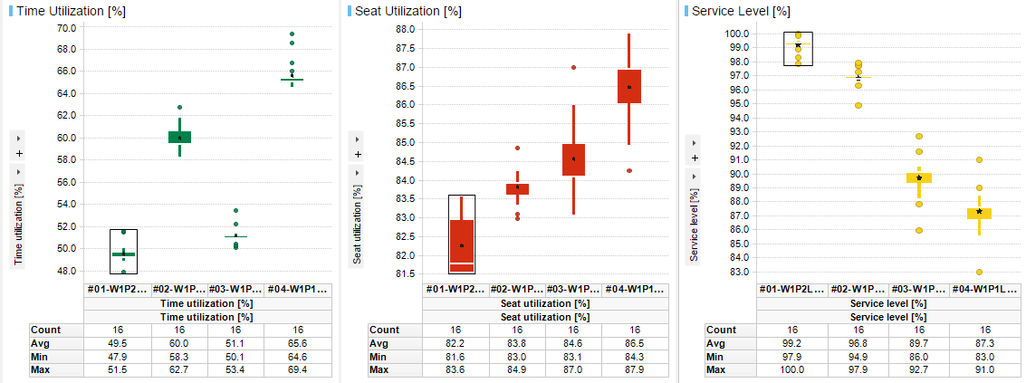
Initial simulation suggests 97% service level achievable with 4 Airframes with active demand management
Best case scenario in terms of service levels
Insights
Overview of Simulated Performance for 4 scenarios
Approach:
Utilising simulation developed for helibases optimisation
Simplified assumptions:
Actual Demand Week 27 2019 (vs full year modelling)
Fixed demand (vs optimisation/re-routing)
66 hours per week per airframe fixed availability assumed (no buffer capacity for disruptions, demand peaks and safety flights modelled)
Outcomes:
The best case scenario (removing 1 airframe in PH) allows for 97% service level before demand optimisation
Time utilisation to be increased from 50% to 61%
Seat utilisation to be increased from ~83% to ~84%
Further potential improvements:
Better planning and/or changing PAX origin base location per customer location/destination could allow meeting same service levels as with 5 airframes
Current state
5 helicopters:
1x in Warri
2x in Lagos
2x in Port Harcourt
Scenarios:
Scenario 1: As-Is
Scenario 2: Heli less in PH
Scenario 3: Heli less in Lagos
Scenario 4: Heli less in both PH and Lagos

Slide 4
$350k monthly savings can be achieved from October 2020
Expected savings, $
Monthly aircraft rent USD element
RW AW139 MSC rate per aircraft per month
Monthly aircraft rent NGN element
RW AW139 MSC rate per aircraft per month at 360 NGN/USD FX rate
Charge for flying hours
0
Assumed 0 charge for the flying hours as the flying hours assumed to be rebalanced between 4 airframes
Total monthly savings

Slide 5
5 key risks have been identified
Theme
Risk
Mitigation measure
Decreased service levels (inability to meet demand)
Future demand above historic averages (e.g., spike in the activities post-COVID)
Emergency response requirements above base assumptions
Insufficient dedicated capacity to meet the demand with 1 airframe less for any helibase
Increased rates on remaining aircrafts if vendor is unable to breakeven with reduced scope of services
Contractual limitations for “capacity pooling” due to structure (2 contracts currently for 2+3 helicopters potentially assigned to certain bases)
Incorporate activity based long-term demand planning (vs operational 2 weeks outlook) into e2e LMS to improve demand visibility in the scheduling horizon, stabilize integrated work schedule and agree improved control of demand changes
Buffer capacity to meet emergency requirements to be tested and clearly documented during “Demand on paper” exercise; active demand management to have clear action plan in case if demand cannot be met
Adopt “capacity pooling” approach to demand planning (vs currently dedicated airframes approach)
Leverage planned work off-shore (Work Orders) to smoothen peaks and troughs in demand for passenger movement
Agree integrated logistics scheduling process with the business during stakeholder engagement sessions to ensure buy-in and collaboration
Optimise demand further (routing optimisation, surveillance flights optimisation etc.) as part of business as usual activities
Value erosion
Develop clear negotiation strategy incl. BATNA
To be validated

Slide 6
L3 implementation plan has been developed
today

Slide 7
Ask from the cadence
Approval to start vendor engagement

Slide 8
Back-up >>>

Slide 9
